Slide 1




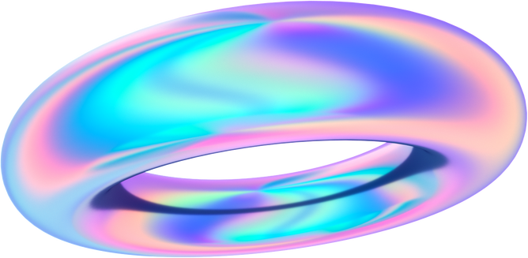

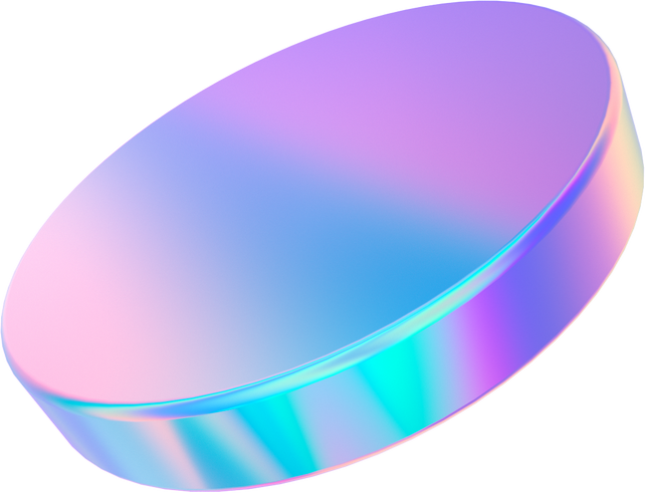
IEEE SSH 2024
HACKATHON
KATHON

Slide 2
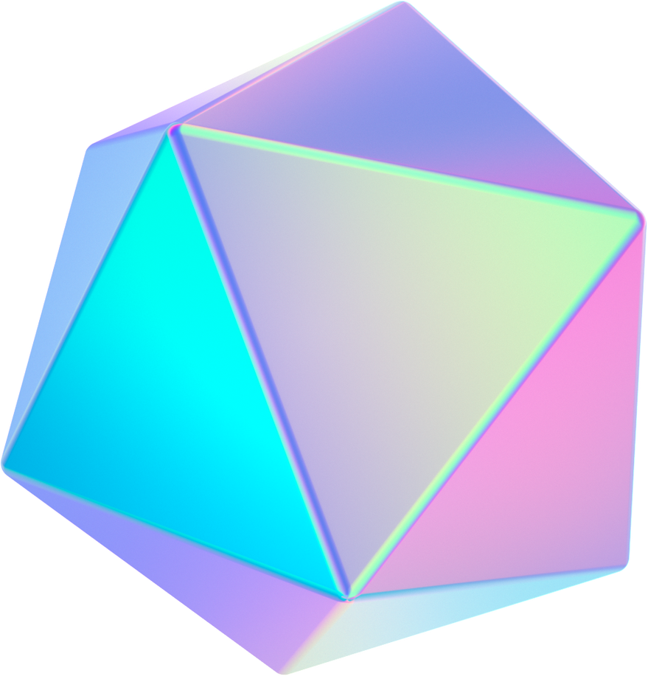

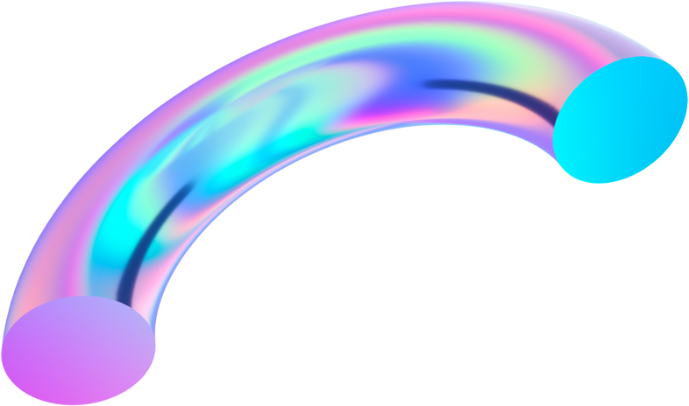
Team name:
ASTEROID DESTROYER
Team Members name:
GAURIYANSH KALRA
VANSHIKA MITTAL
KARTIK VERMA

Slide 3
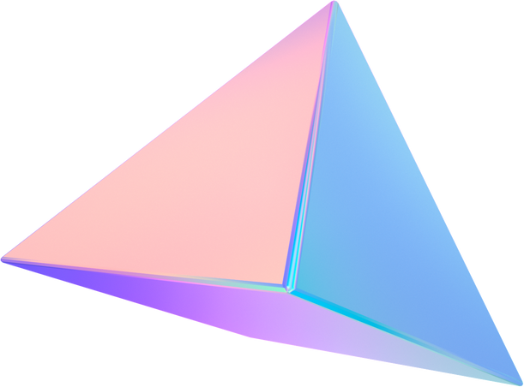
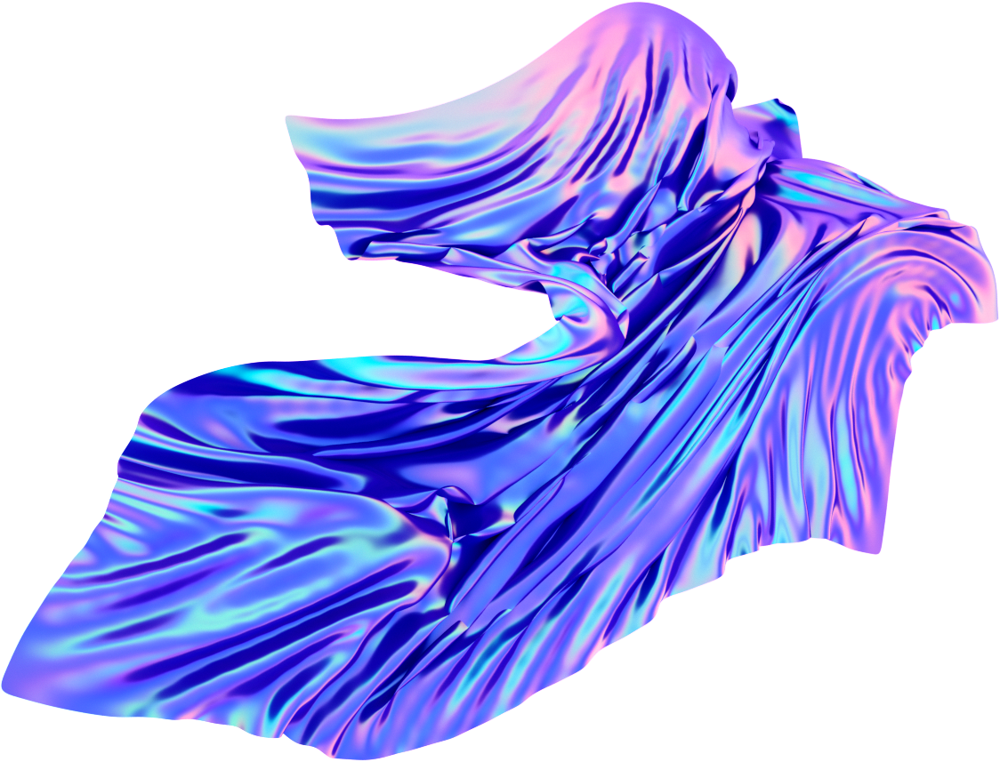
Problem statement
Learning App for Deaf and Mute: Sign Language to Gujarati/English Converter

Slide 4

Solutions
Video Capture:
The app will use the device’s camera to capture real-time video of the user's hand gestures.
OpenCV will handle this video input, processing each frame to identify and isolate hand movements for further analysis.
Machine Learning Translation:
The detected hand keypoints will be passed to a pre-trained machine learning model developed using TensorFlow.
This model has been trained on a sign language dataset containing labeled gestures for different signs (such as letters, words, or phrases).
Using Datasets for Training:
A large, annotated sign language dataset is used to train the TensorFlow model. This dataset contains multiple video samples of various hand gestures, ensuring the model learns to recognize a wide range of signs.
Each sign is labeled with its corresponding textual meaning (e.g., "hello," "thank you"), which helps the model learn the correct translation from gestures to text.

Slide 5
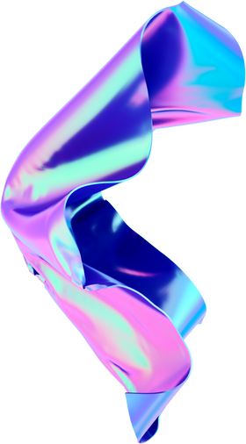
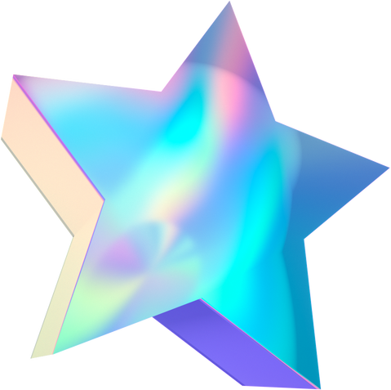
USP
Our app provides real-time sign language to text conversion in both Gujarati and English, making communication easier for the deaf and mute community. Powered by advanced computer vision and machine learning ,it ensures highly accurate gesture recognition. Its multi-language support and cross-platform compatibility set it apart, with continuous improvement through expanding datasets.

Slide 6
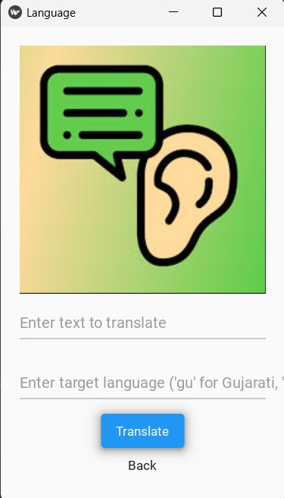
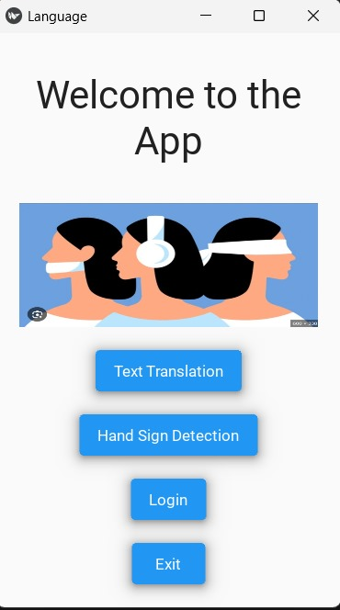
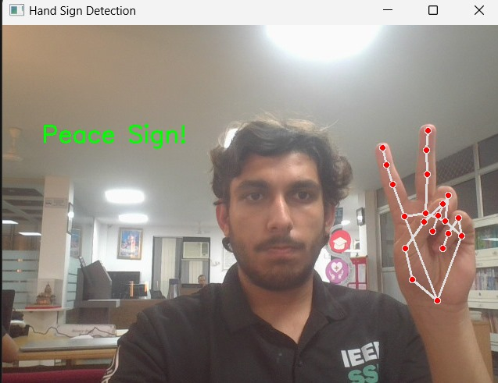
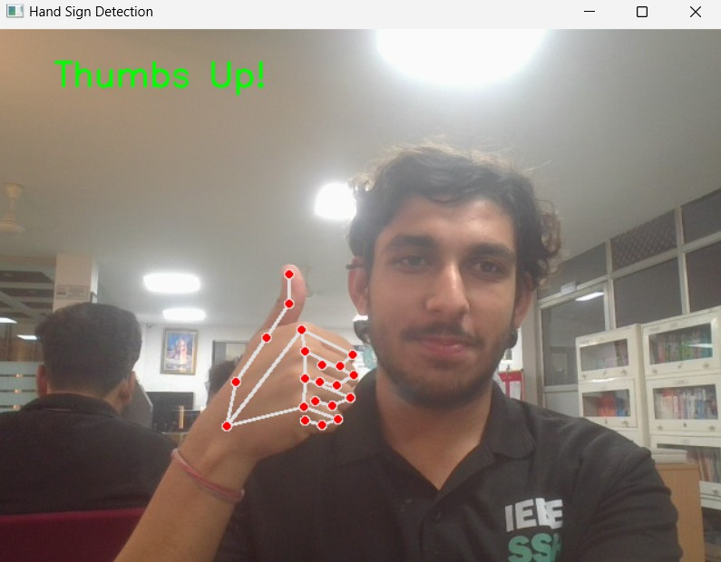
PROTOTYPES

Slide 7


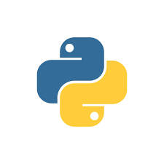
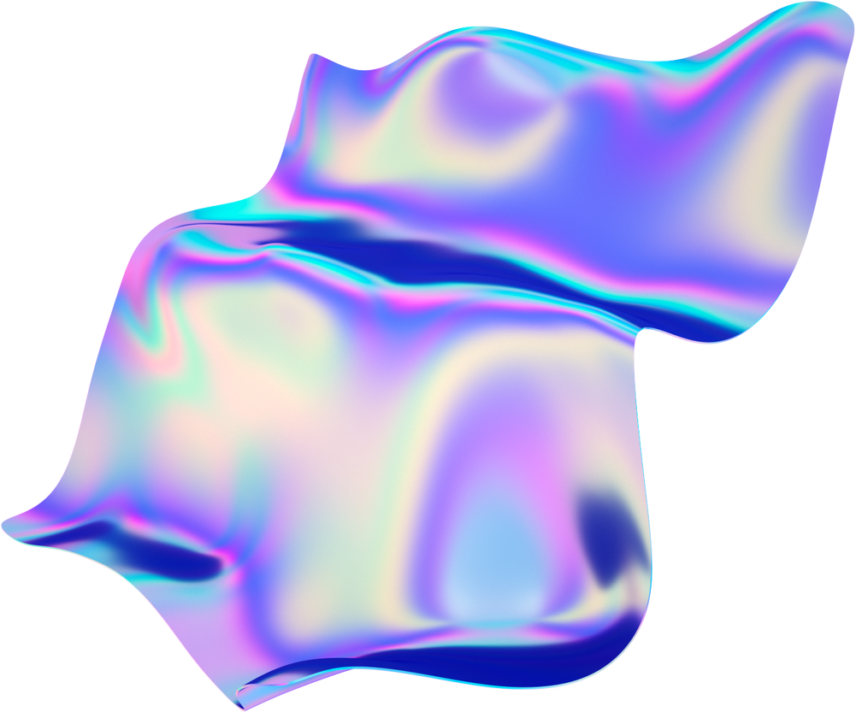
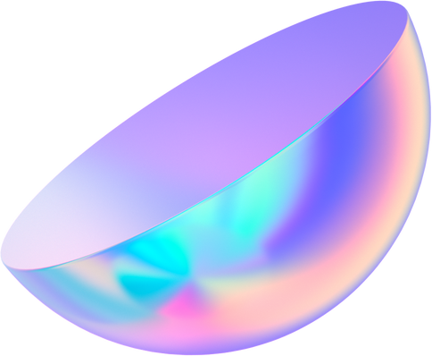
Tech Stack
OpenCV
TensorFlow
Python

Slide 8
Features
Hand Gesture Recognition: The app uses computer vision techniques (e.g., OpenCV, MediaPipe) to detect hand gestures in real time.
English to Gujarati Translator: The app can translate English text input into Gujarati, displaying the translated output instantly. Users can type English sentences or words, which will be translated to Gujarati and shown on the screen.
Tutorials :- We have added tutorial videos for beginners who are trying to learn sign-language
Text Display: Converts recognized gestures into written text displayed on the screen, making it easier for non-signers to read and understand.

Slide 9
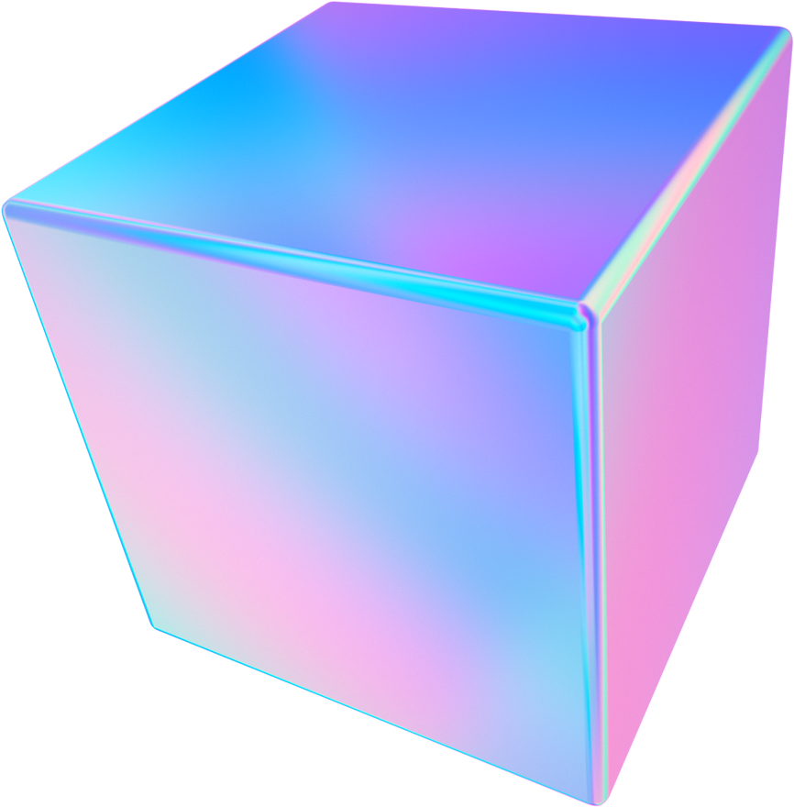
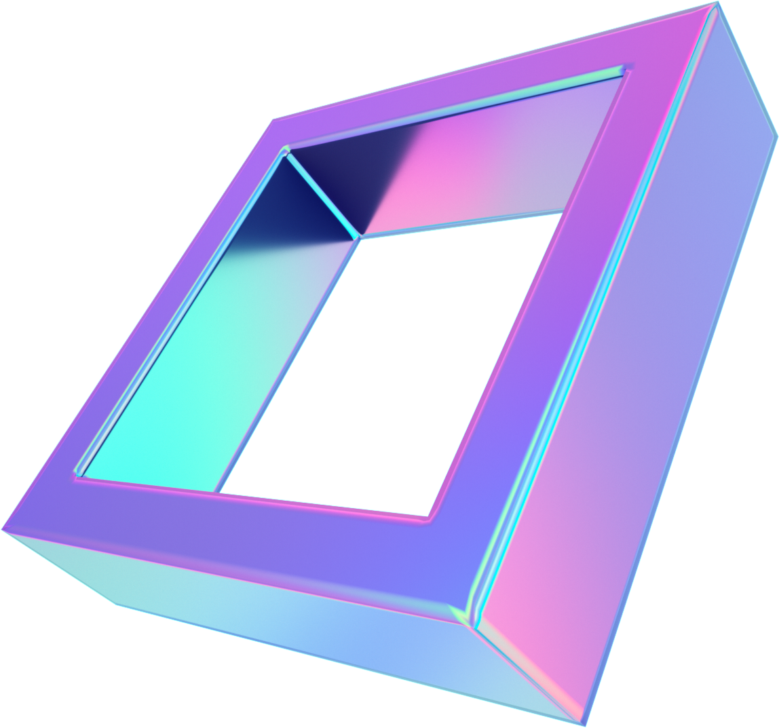
Future aspect
The app's future includes expanding support for multiple sign languages, adding text-to-speech for spoken translations, and enabling users to teach the app custom signs. Continuous machine learning updates will enhance accuracy, while AI-based feedback can help users learn gestures. Cross-device synchronization will allow personalized experiences across platforms, and future integration of augmented reality (AR) could provide immersive, interactive learning environments.

Slide 10
Thank You

